Slide 1

SPERANZA MOULDS & PLASTIC INDUSTRY
Solution Provider for all kind of Injection Moulds, Jigs, Fixtures & Parts

Slide 2
History
Vision / Mission
3.Plant Details
4.Organisation Structure 5.Machine Details
6.Customer Details
7.Sample / Manufacturing

Slide 3
Over 7 Years of Experience
In December 2026
2019
2021
March 2026
2020
2025
Started the Company with EDM Wire cut Machine
Added
VMC Machine & EDM Drill
Added EDM Sparking, Conventional Surface Grinding M/c & Conventinal Milling M/c
Added 1 more VMC Machine with Propping (Direct Drive Spindle with 12,000 Rpm and 1 more EDM Sparking
To be Plan additional 2 more VMC Machine with Propping (Direct Drive Spindle with 12,000 Rpm and 2 more EDM Sparking
To be Plan 100 Ton to 600 Ton 5 Nos of Injection Moulding Machines

Slide 4

Vision / Mission
Vision :
To be the most valued supplier of high precision Injection Moulds for the Automotive and Semi- Conductor Industry .
Mission :
To manufacture high precision Tool and die and Spares, Moulds to the Automotive and Semi conductor industry by creating a world class manufacture with a safe and healthy work environment, and developing a highly skilled and motivated team that values relationship built on integrity with our co-workers, customers and communities .By continuously upgrading
infrastructure ,Upskilling our team members and evolving a robust
manufacturing process ,we strive to exceed customer expectation by being right,the first time and every time.

Slide 5
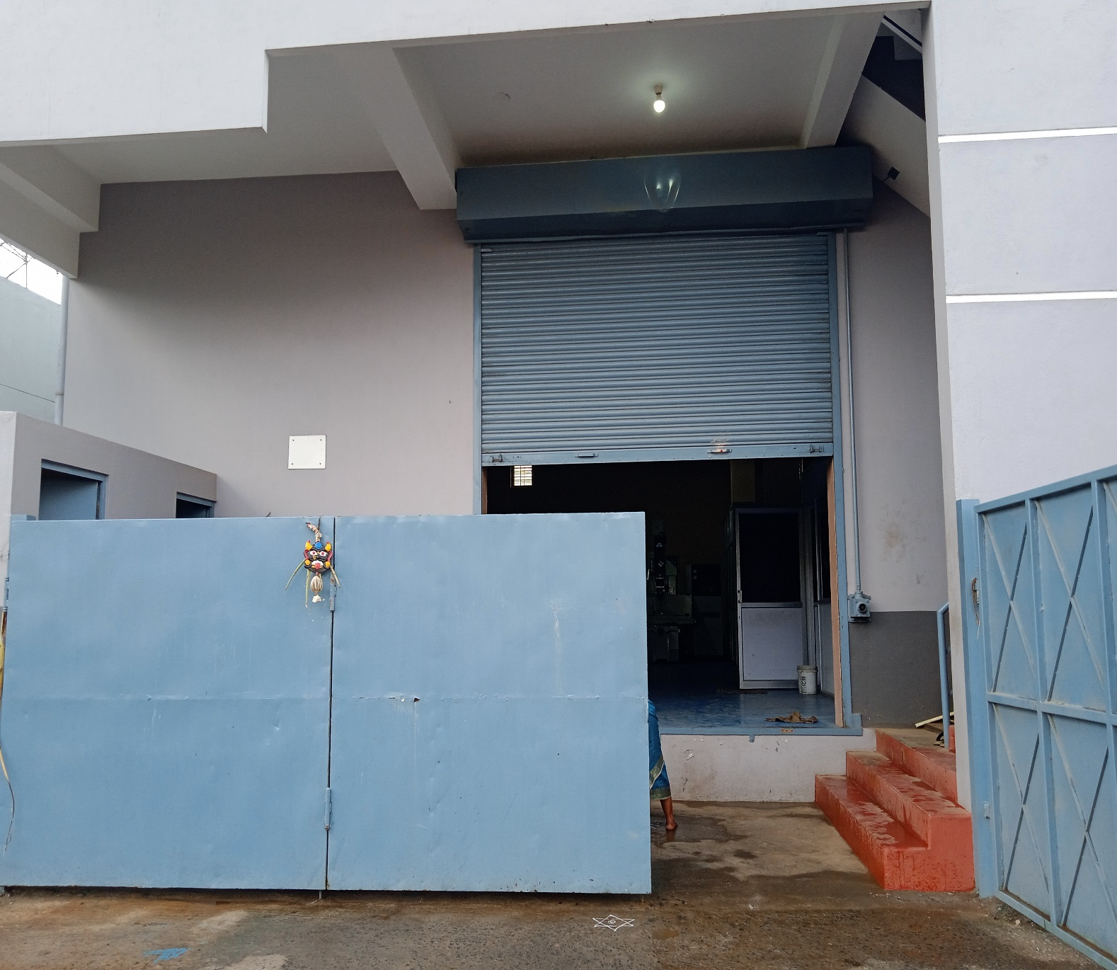

Plant Details
Company Inception : 2019
Plant Size : 2000 Sqft. No of Employees : 20
Power Capacity : 35HP

Slide 6
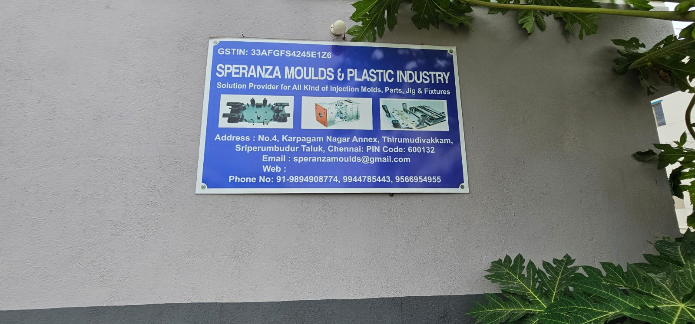
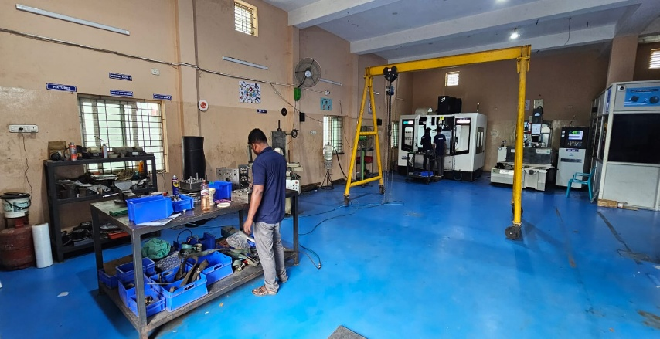
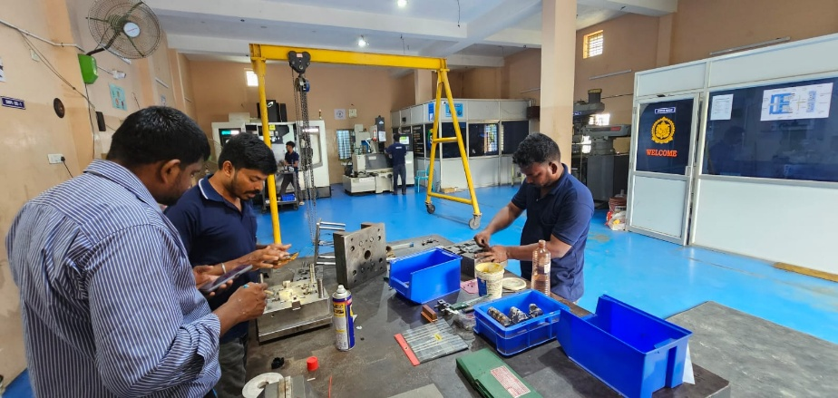
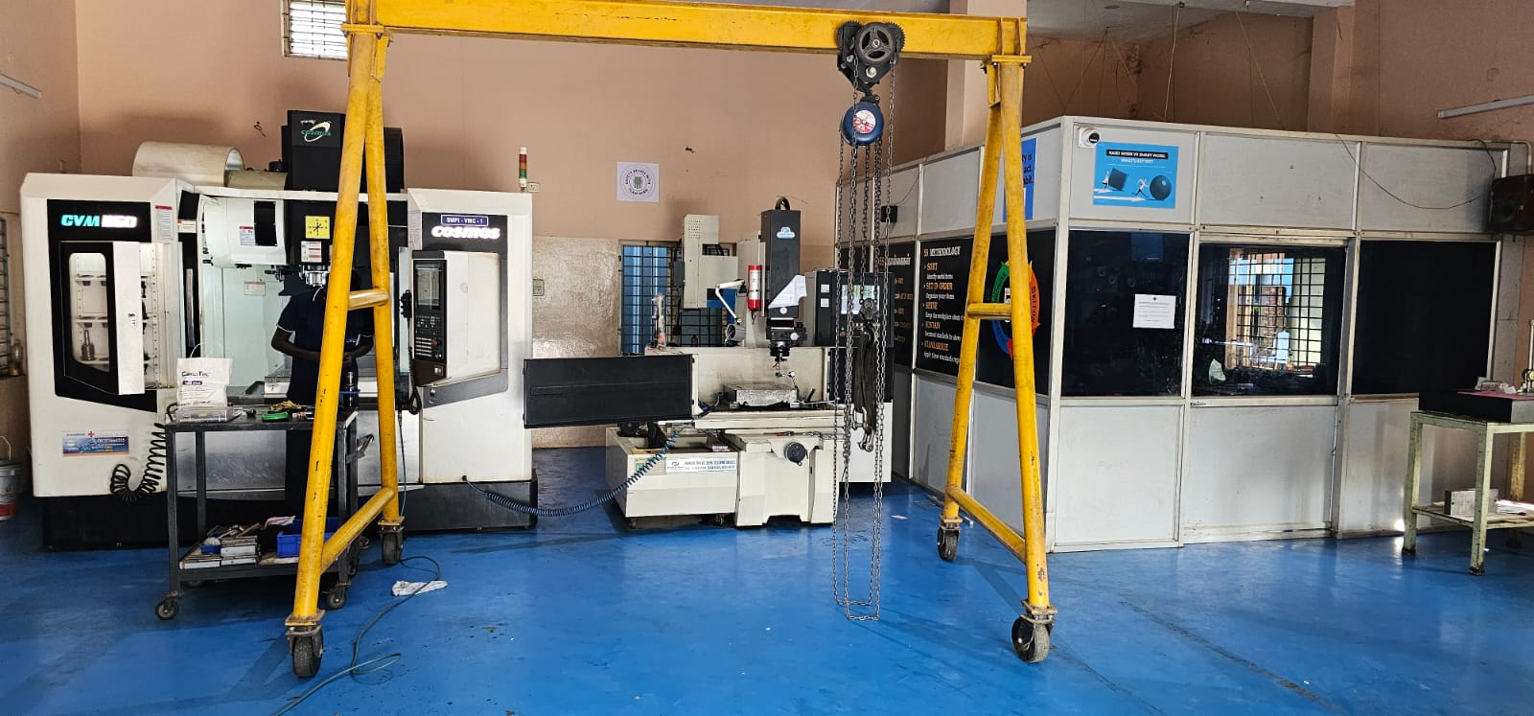
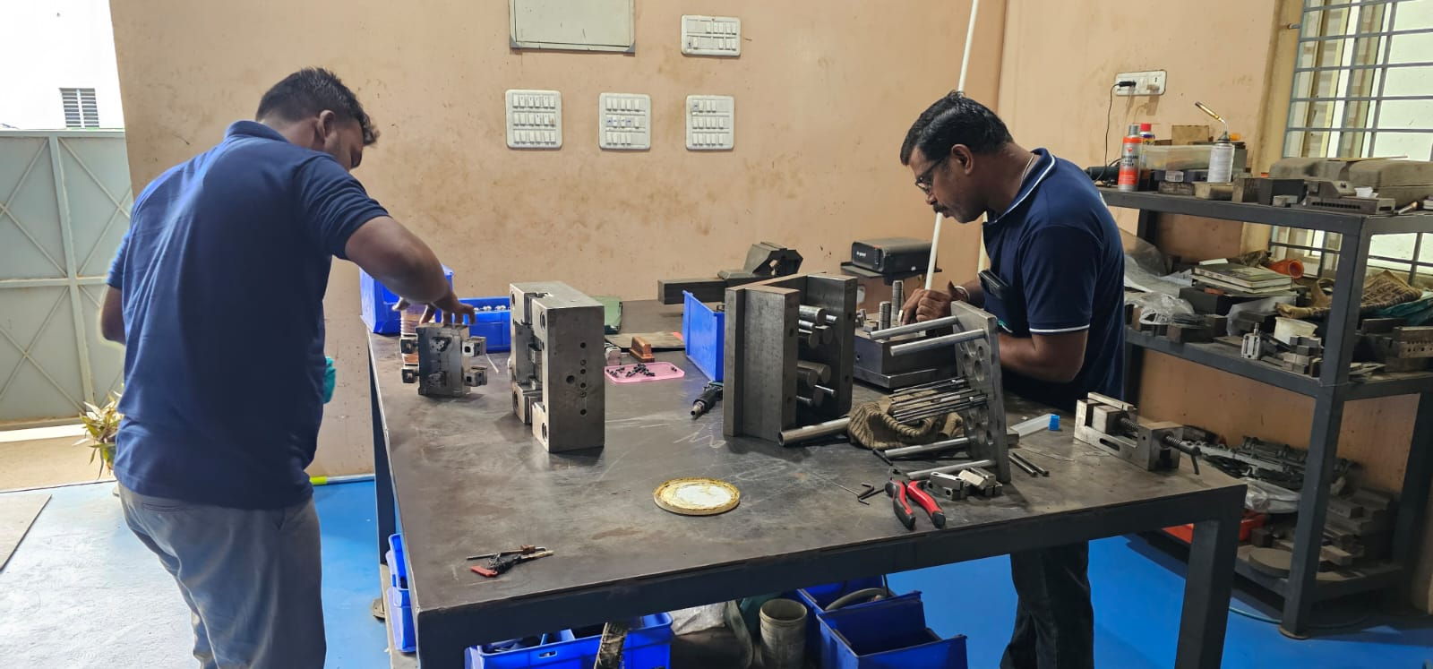
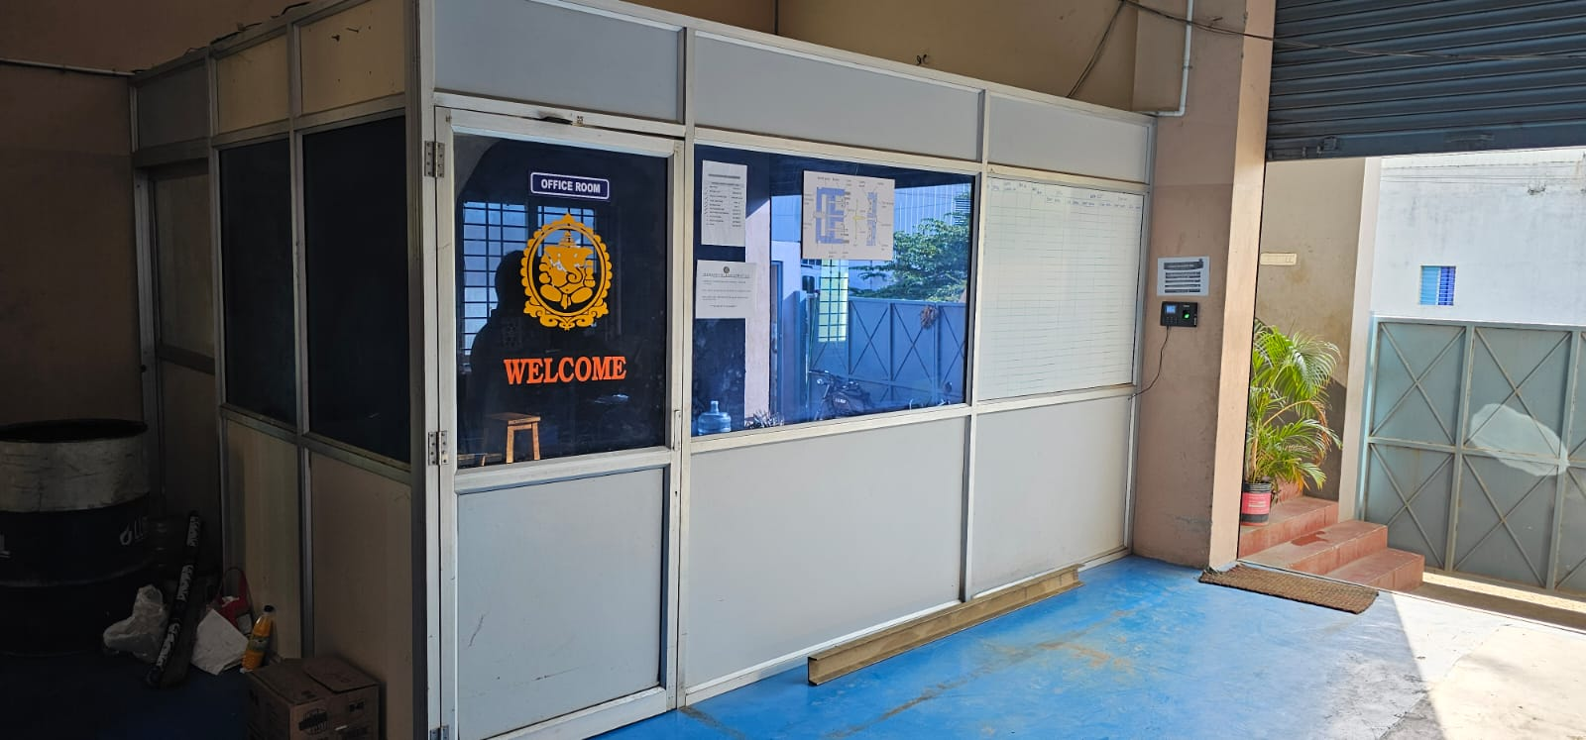
Plant Images

Slide 7
Department Structure (Shop Floor)
Machines Details
EDM Sparking
Make : "Power Drive” & “JOEMARS” Qty of M/c: 2 Nos
CNC Milling(VMC) Make : Cosmos
Qty of M/c: 2 Nos
EDM Super Drill
Make : Power Drive
Qty of M/c: 1 No
Grinding
Make : Okamoto
Qty of M/c: 1 No
Conventional Milling Make: Bridgeport Qty of M/c: 1 No
EDM Wire Cut
Make : Mitsubushi
Qty of M/c : 1 No

Slide 8
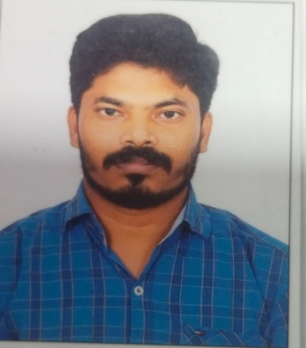
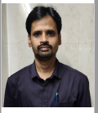
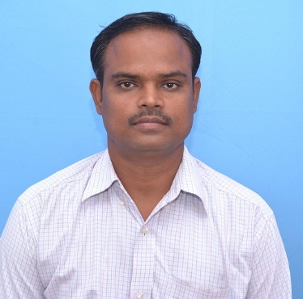
Profile Details
M.Venkatesan(Partner)
Mould Manufacturing
M.Jaiprakash (Partner) Purchase/Quality
G.Jayaprakash(Partner) Sales/Admin/Accounts
Having total experience of 20 Years in the field of Moulds.
Specialist in MOULDING, EDM /CNC Milling.
Having sound knowledge in Quality Systems
Having total experience of 23
Years in the field of VMC Machining and Manufacturing
Specialist in EDM /CNC Milling
Having total experience of 23 years.
Having 12 Years experience in Upgradation and Execution.
Having 11 Years experience in Business.

Slide 9
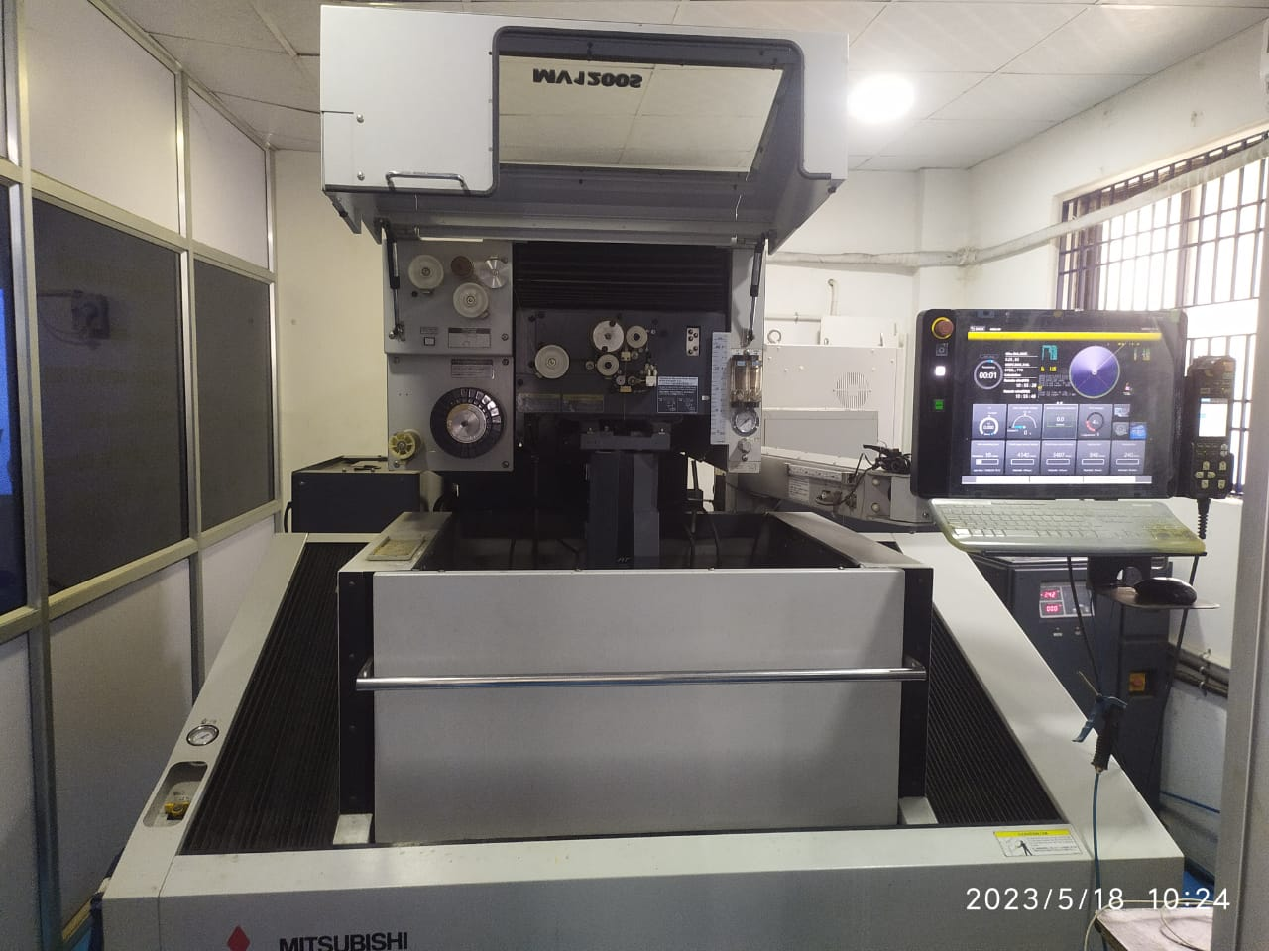
M/C Details- EDM Wire cut
Make :MITSUBISHI WIRECUT
Model No : MV1200S
Table Size : 600*500
XYZ Travel : 400*300*220
Accuracy : 0.002
Year of Mfg : 2019

Slide 10
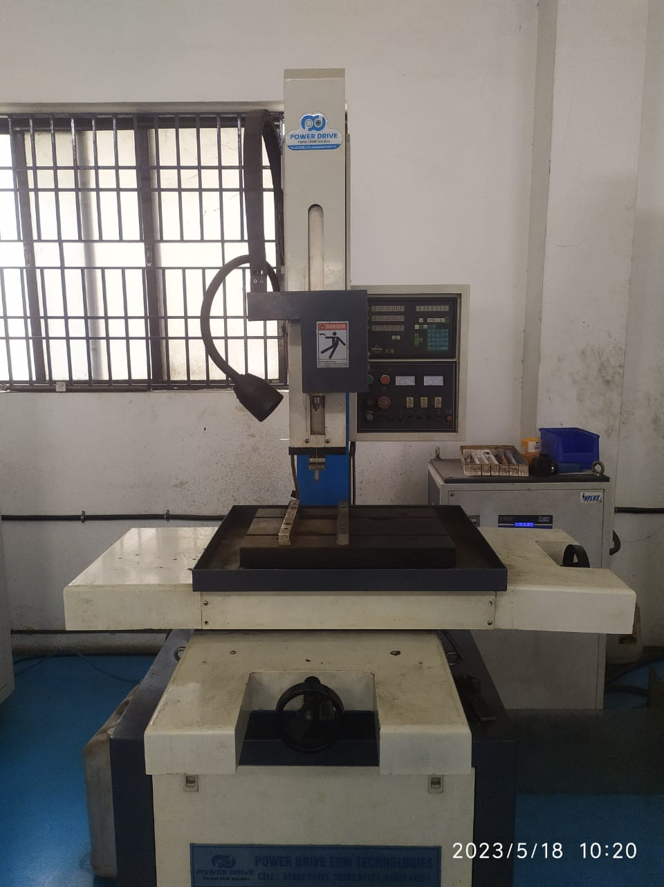
M/C Details- EDM Drill
Make : POWER DRIVE EDM DRILL
Model No : S3
Table Size : 500*400
XYZ Travel : 400*300*300
Accuracy : 0.05
Year of Mfg :2020

Slide 11
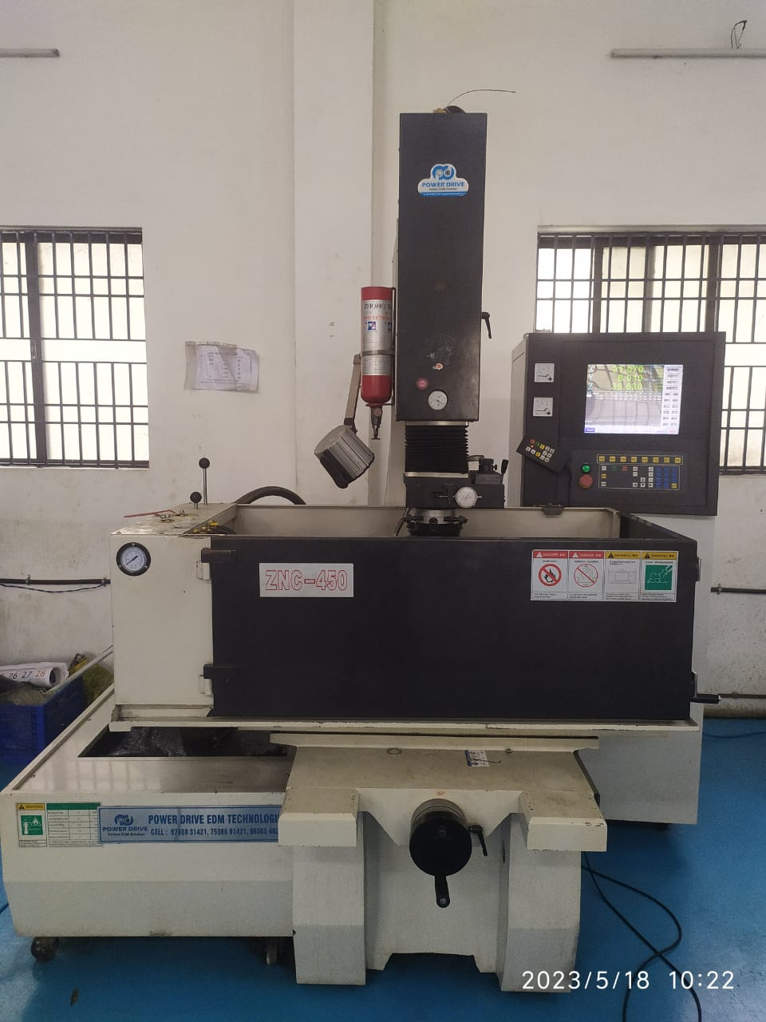
M/C Details- EDM Sparking
Make : POWER DRIVE EDM SPARKING
Model No : ZNC-450
Table Size :700*450
XYZ Travel: 450*350*450
Accuracy : 0.005
Year of Mfg :2021

Slide 12
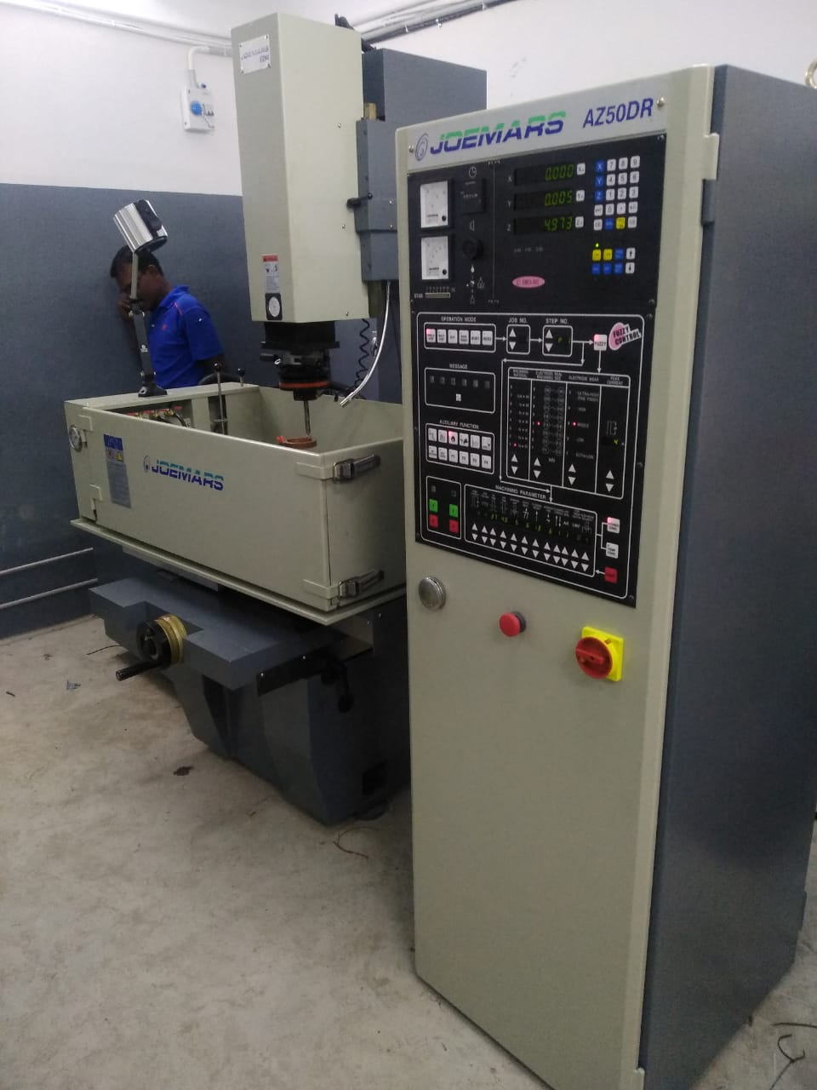
M/C Details – EDM Sparking
Make : JOEMARS
Model No : JM-430
Table Size :650 X 400mm
XY Travel: 400 *300 *400 mm
Accuracy : 0.005
Year of Mfg :2025

Slide 13
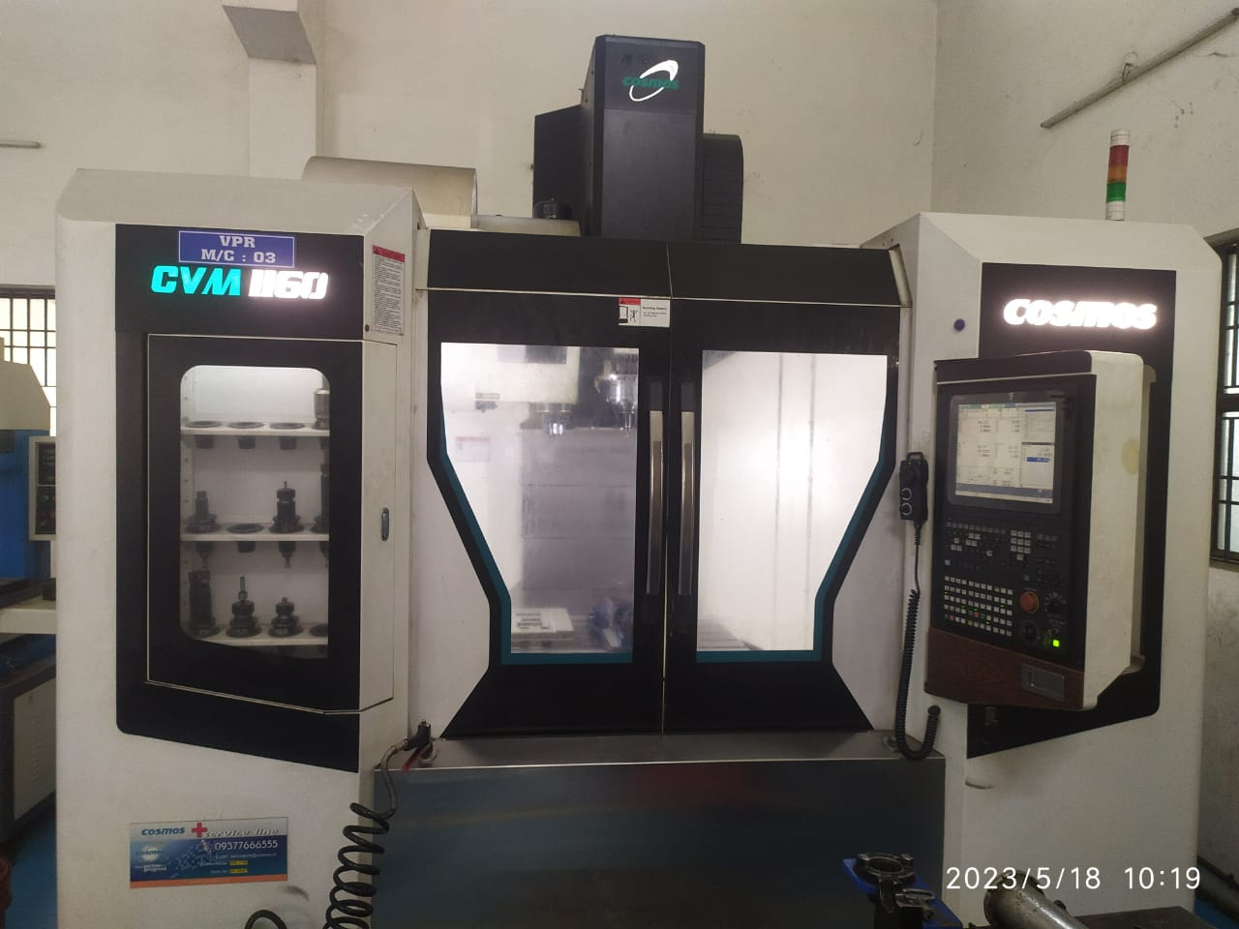
M/C Details- CNC Milling
Make : COSMOS VMC
Model No : CVM 1160
Table Size : 1200*600
XYZ Travel :1100*650*600
Spindle RPM :12000 (WITH DIRECT DRIVE)
Control :Mitsubishi
Year of Mfg :2020
Accuracy : 0.01

Slide 14
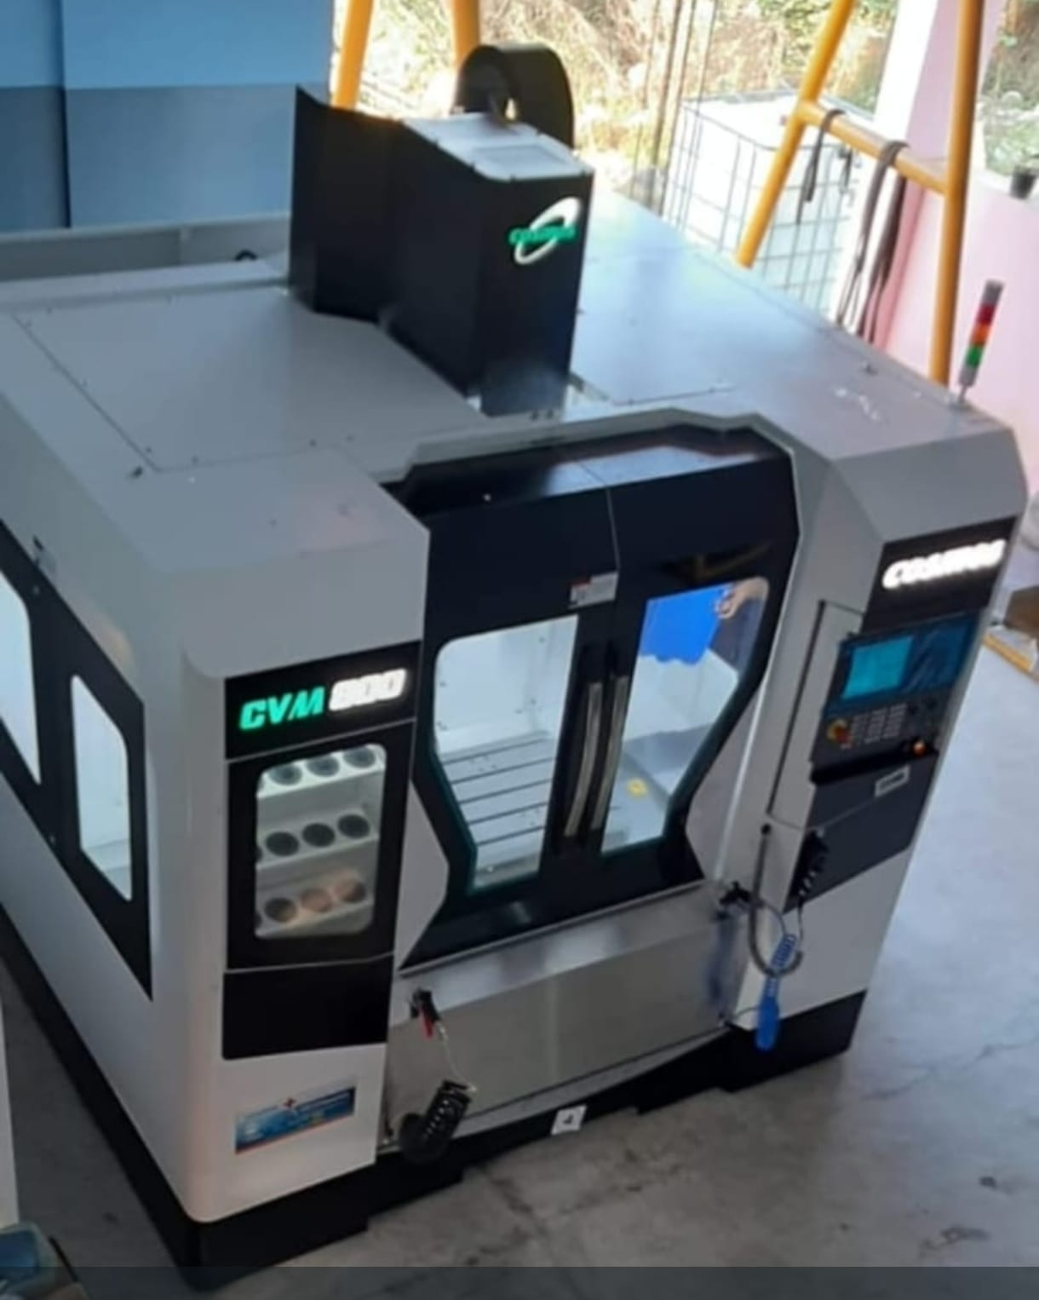
M/C Details- CNC Milling
Make : COSMOS VMC
Model No : CVM - 800
Table Size : 1000*500 mm
XYZ Travel :800*500*500 mm
Spindle RPM :12000 (WITH Propping)
Control :Mitsubishi
Year of Mfg :2025
Accuracy : 0.003

Slide 15
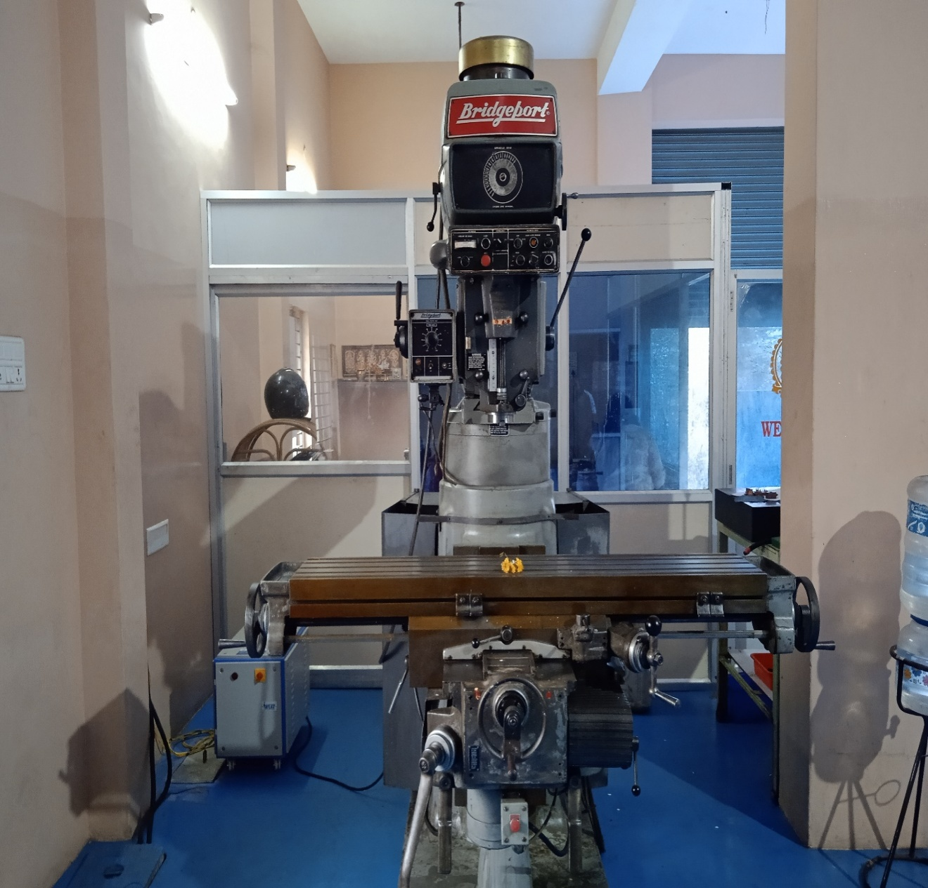
M/C Details- Conventional Milling
Make : Bridgeport Milling
Table Size : 1200*400
XYZ Travel :850*450*600
Spindle RPM :4500
Accuracy : 0.02

Slide 16
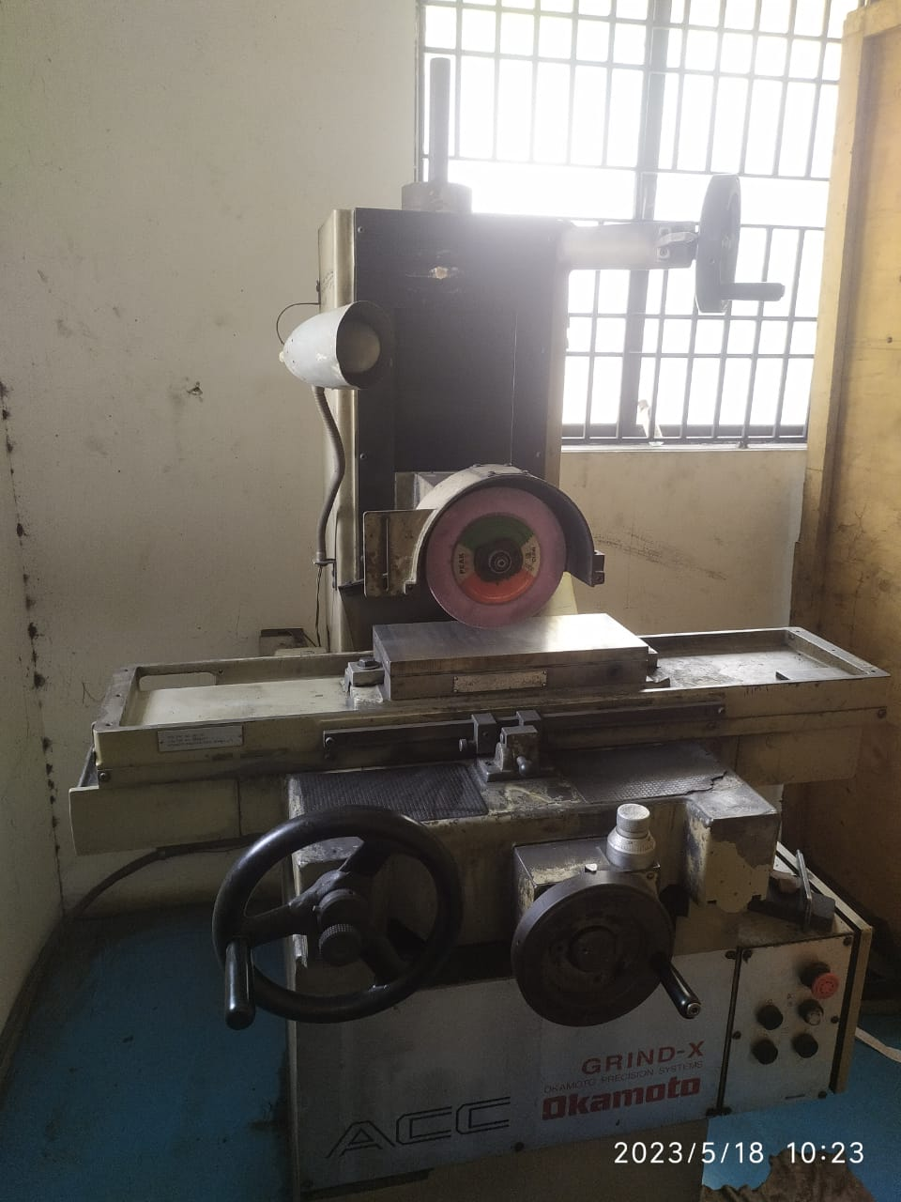
M/C Details- Conventional(S/G)
Make: OKAMOTO GRINDING
Modal No :ACC -35011
Table Size : 365*150
XYZ Travel :375*175*
Accuracy : 0.002

Slide 17
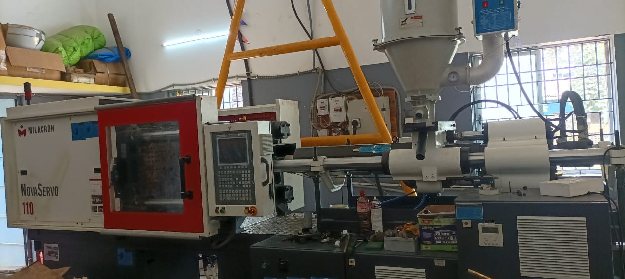
M/C Details- Conventional(S/G)
Make: Milacron
Modal No :Nova Servo-110 T
Screw Type: Normal
Short capacity:272(gm)
Screw Diameter:45 mm
Tie bar distance: 435 X 435 mm
Patten size:655 X 655 mm
MIN Mold thickness: 150 mm
MAX mold thickness: 480 mm
MAX day light :830 mm
Hydraulic core pull: 1
Air ejection :1

Slide 18
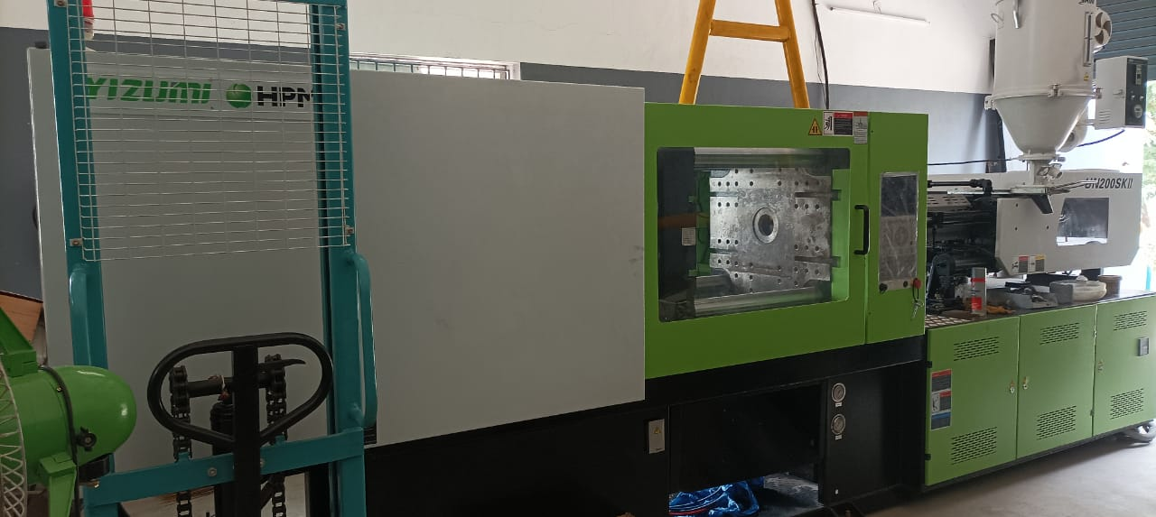
M/C Details- Conventional(S/G)
Make: YIZUMI
Modal No :Hpm 200T
Screw Type: BI-METALLIC
Short capacity:477(gm)
Screw Diameter:53 mm
Tie bar distance: 510 X 510 mm
Patten size:760 X 760 mm
MIN Mold thickness: 180 mm
MAX mold thickness: 520 mm
MAX day light :980 mm
Hydraulic core pull: 1
Air ejection :1

Slide 19











List of Customers

Slide 20
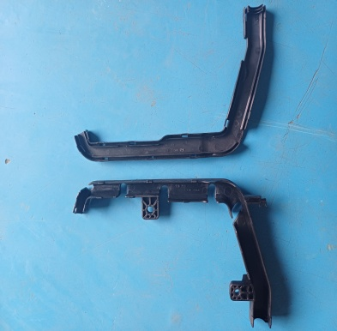
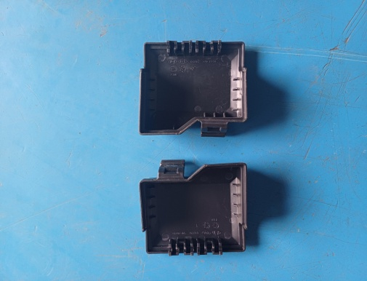
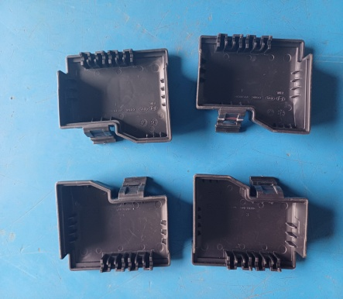
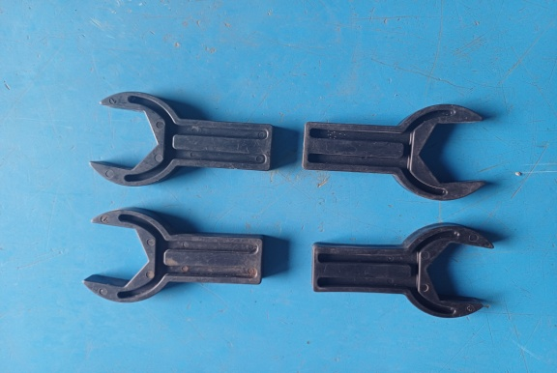
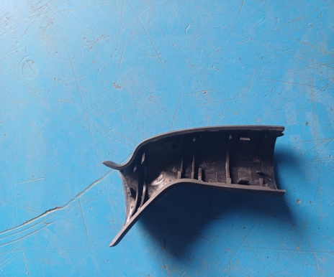
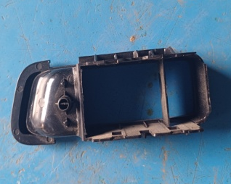
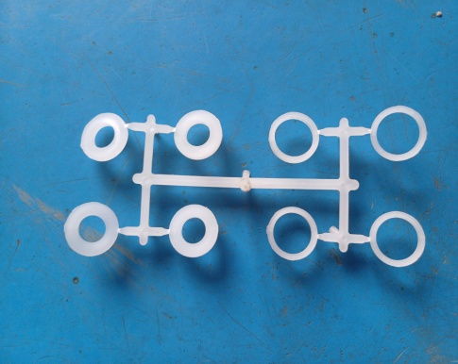
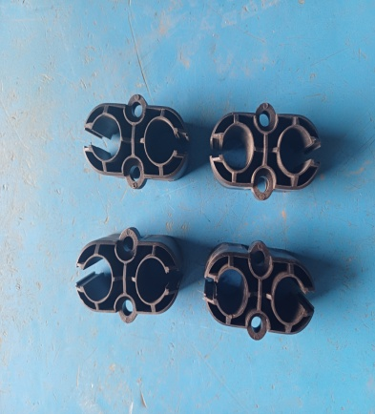
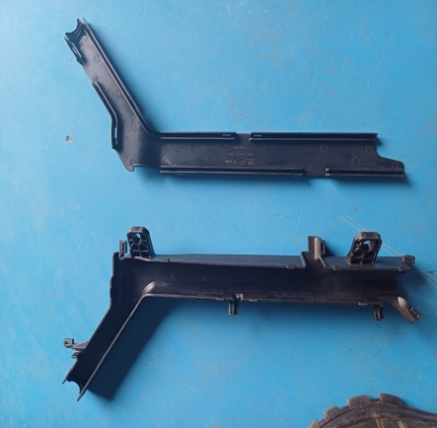
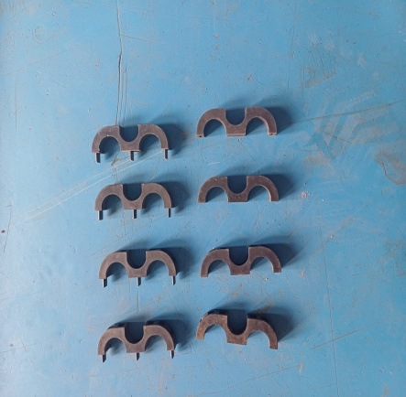
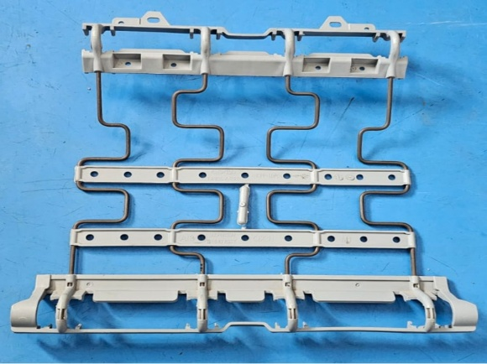
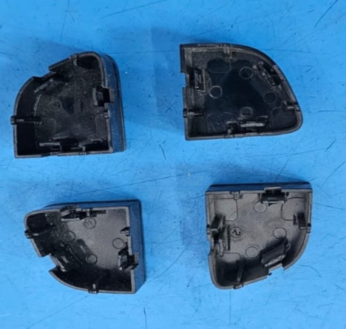
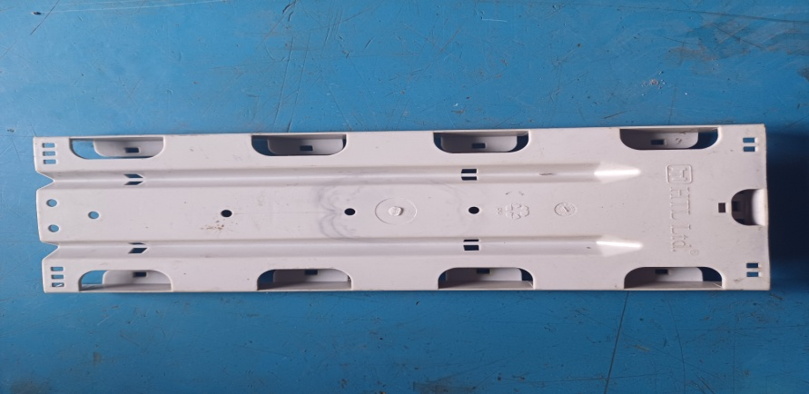
Sample/Manufacturing

Slide 21
Contact Details
Contact Number : 9790484994, 9944785443, 9566954955
Email id : speranzamoulds@gmail.com
Website : https://speranzamoulds.com
Address: Plot No:4 Karpagam Nagar Annex
Thirumudivakkam
Chennai -600132
THANK YOU

Slide 22
**THANK YOU**

